Slide 1
for loop
The most popular looping instruction
The for loop allows us to specify three things in a single line
Initialization:
Setting a loop counter to an initial value
Condition:
Testing loop counter to check whether it reaches the desired number of repetitions
Increment / decrement part:
Increase or decrease the value of loop counter each time when the statement within the loop are executed

Slide 2
General form of for loop
for ( ; ; )
{
do this;
and this;
and this;
}
initialization
condition
Incr/ decr
Incr/ decr stands for increment/ decrement

Slide 3
Sequence of execution of for loop
1
2
5
8
4
7
for ( ; ; )
{
do this;
and this;
and this;
}
initialization
condition
Incr/ decr
3
6

Slide 4
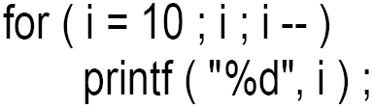
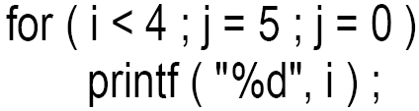
Cont.
It is important to note that the initialization, testing and increment part of a for loop can be replaced by any valid expression.

Slide 5
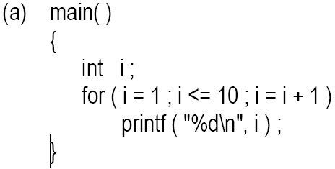
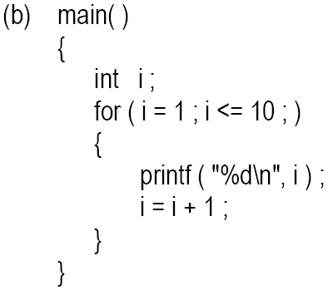
Ways for writing for loop

Slide 6
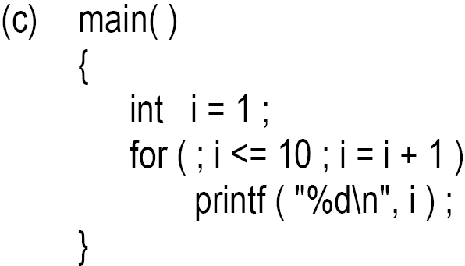
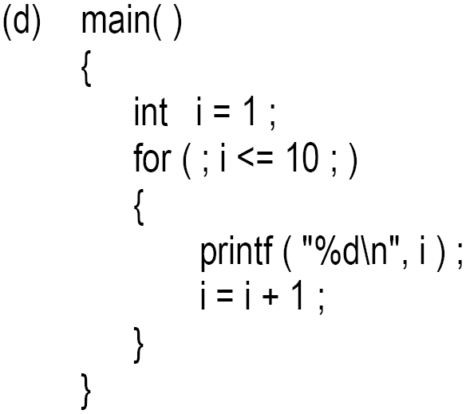
Cont.

Slide 7
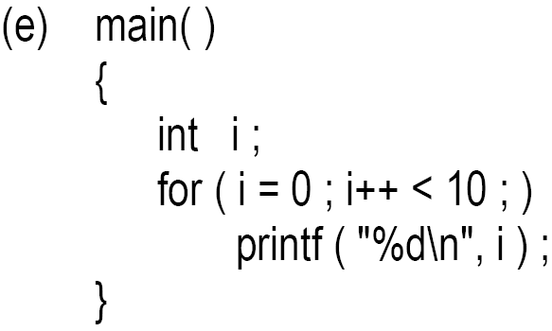
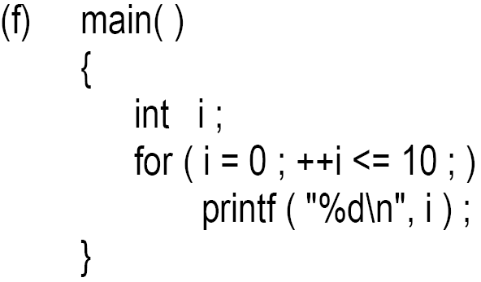
Cont.

Slide 8
Nested for loop
/* Demonstration of nested loops */
main( )
{
int r, c, sum ;
for ( r = 1 ; r <= 3 ; r++ ) /* outer loop */
{
for ( c = 1 ; c <= 2 ; c++ ) /* inner loop */
{
sum = r + c ;
printf ( "r = %d c = %d sum = %d\n", r, c, sum ) ;
}
}
}

Slide 9
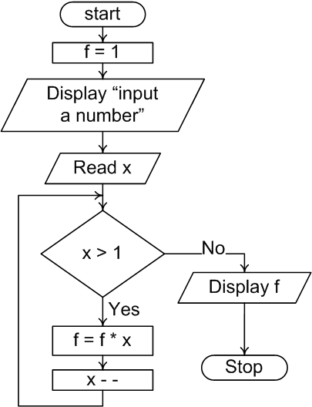
Example program 1
Write a program to find the factorial value of any number entered through the keyboard.

Slide 10
Example program 2
Write a program that displays the table of x up to y. The value of x and y is input by the user.
e.g. x = 4 and y = 5
4 x 1 = 4
4 x 2 = 8
4 x 3 = 12
4 x 4 = 16
4 x 5 = 20

Slide 11
The break Statement
There are situations where we want to jump out of a loop instantly, without waiting to get back to the conditional test.
The keyword break allows us to do this
When break is encountered inside any loop, control automatically passes to the first statement after the loop.
A break is usually associated with an if.
The keyword break, breaks the control only from the loop in which it is placed

Slide 12
Cont.
Example: Write a program to determine whether a number is prime or not. A prime number is one, which is divisible only by 1 or itself.

Slide 13
break statement in nested loop
main( )
{
int i = 1 , j = 1 ;
while ( i++ <= 100 )
{
while ( j++ <= 200 )
{
if ( j == 150 )
break ;
else
printf ( "%d %d\n", i, j ) ;
}
}
}

Slide 14
The continue Statement
continue statement allows to take the control to the beginning of the loop, bypassing the statements inside the loop, which have not yet been executed
A continue is usually associated with an if.

Slide 15
The do-while Loop
Post test repetition structure
The statement in the loop block are executed at least once, whether the loops condition is true or false
do
{
this ;
and this ;
and this ;
} while ( this condition is true ) ;

Slide 16
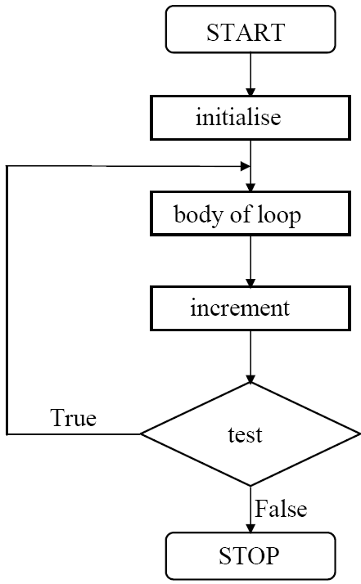
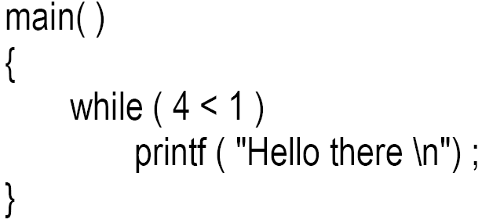
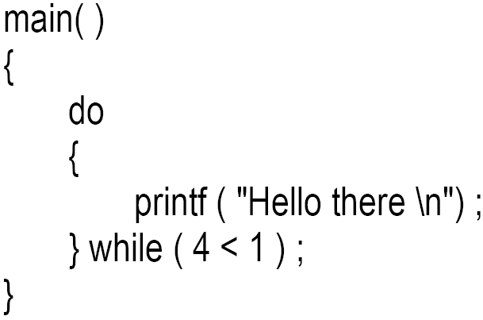
General form of do while loop

Slide 17
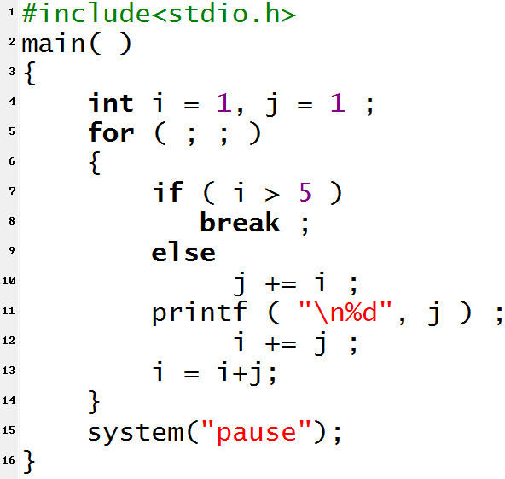
Example program
Program output
2
7
j = j + i;
i = i + j;

